Slide 1
Decision Tree

Slide 2
Decision Tree
A decision tree is a tree-like structure that is used as a model for classifying data. It decomposes the data into sub-trees made of other sub-trees and/or leaf nodes.
Terminologies of decision tree:
Decision Nodes: These type of node have two or more branches
Leaf Nodes: The lowest nodes which represents decision
Root Node: This is also a decision node but at the topmost level
Splitting: It is a process of dividing a node into two or more sub-nodes.

Slide 3
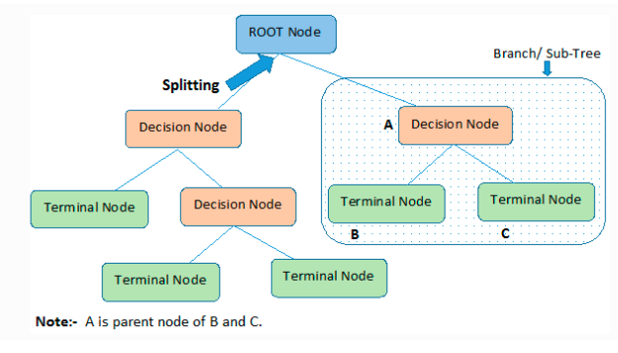
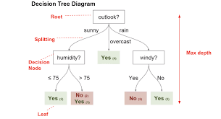
Decision Tree

Slide 4
Decision Tree Algorithms
The basic idea behind any decision tree algorithm is choosing the best attribute(s) to split the remaining instances and make that attribute a decision node.
We repeat this process recursively for each child.
The stopping criterion is generally one of the following, either all the instances have the same target attribute value, or there are no more attributes or there are no more instances to handle.

Slide 5
How do Decision Trees work?
Decision trees use multiple algorithms to decide to split a node into two or more sub-nodes.
The algorithm selection is also based on the type of target variables. Let us look at some algorithms used in Decision Trees:
ID3 → (extension of D3) Iterative Dichotomiser 3 C4.5 → (successor of ID3) CART → (Classification And Regression Tree) CHAID → (Chi-square automatic interaction detection Performs multi-level splits when computing classification trees) MARS → (multivariate adaptive regression splines)

Slide 6
Attribute Selection Measures
If the dataset consists of N attributes then deciding which attribute to place at the root or at different levels of the tree as internal nodes is a complicated step.
Some criteria are like :
Entropy (attributes to be categorical: ID3)
Information gain (attributes to be categorical: ID3)
Gini index (attributes are assumed to be continuous: CART)
Gain Ratio (C4.5)
Reduction in Variance
Chi-Square

Slide 7
ID3 (Iterative Dichotomiser 3)
ID3 algorithm developed by Ross Quinlan in 1975.
The algorithm is used to generate a decision tree from a dataset using Shannon Entropy.
ID3 employs a top-down greedy search through the space of possible decision trees. The algorithm is called greedy because the highest values are always picked first and there is no backtracking. The idea is to select the attribute that is at that point most useful for classifying examples.
To determine the best attribute, we look at the ID3 heuristic. ID3 splits attributes based on their entropy. Entropy is the measure of disinformation. It comes from information theory. Higher the entropy, higher is the information content. In other words we select the attribute that has the highest information gain.

Slide 8
Steps of the ID3 Algorithm
Determine entropy for the overall the dataset using class distribution.
For each feature.
Calculate Entropy for Categorical Values.
Assess information gain for each unique categorical value of the feature.
Choose the feature that generates highest information gain.
Iteratively apply all above steps to build the decision tree structure.

Slide 9
Information Gain
Information gain assesses how much valuable information an attribute can provide. We select the attribute with the highest information gain, which signifies its potential to contribute the most to understanding the data. If information gain is high, it implies that the attribute offers a significant insight. ID3 acts like an investigator, making choices that maximize the information gain in each step. This approach aims to minimize uncertainty and make well-informed decisions, which can be further enhanced by preprocessing the data.
where,| S| is the total number of instances in dataset.
|S_v| is the number of instances in dataset for which attribute D has values v.
H(S) is the entropy of dataset.

Slide 10
Entropy
Entropy is a measure of disorder in a dataset. A dataset with high entropy is a dataset where the data points are evenly distributed across the different categories. A dataset with low entropy is a dataset where the data points are concentrated in one or a few categories.
H(S)= -(P_i * log_2(P_i))
where P_i represents the fraction of the sample within a particular node.
S – The current dataset.
i – Set of classes in S
If entropy is low, data is well understood; if high, more information is needed. Preprocessing data before using ID3 can enhance accuracy. In sum, ID3 seeks to reduce uncertainty and make informed decisions by picking attributes that offer the most insight in a dataset.

Slide 11
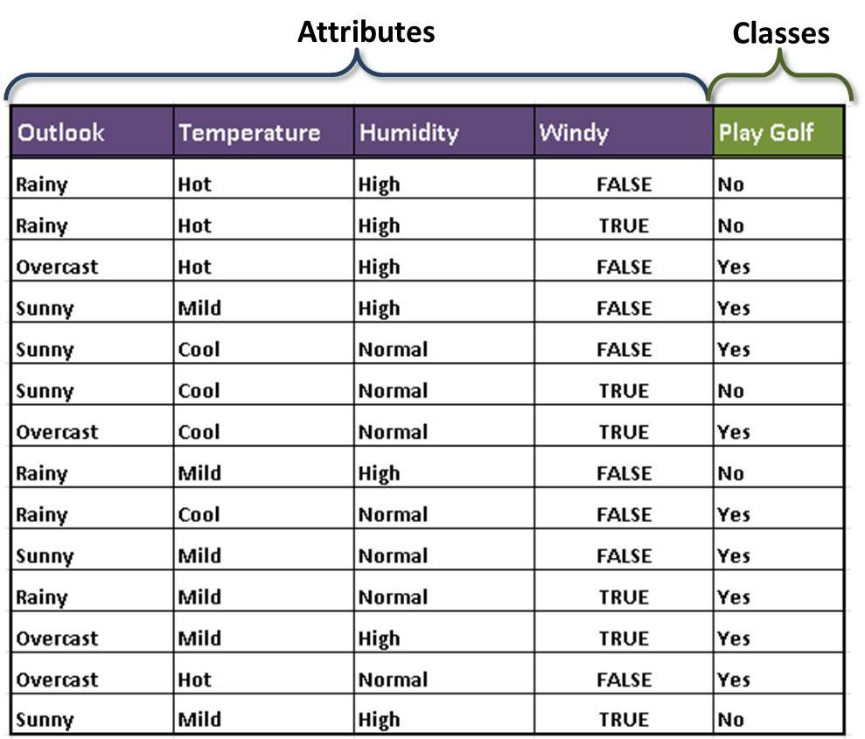
Decision Tree
Consider the table.
It represent factors that affect whether John would go out to play golf or not.
Using the data in the table, build a decision tree to model that can be used to predict if John would play golf or not.

Slide 12
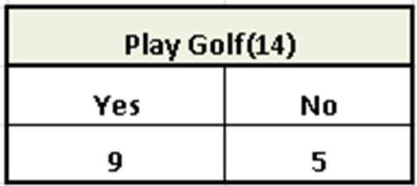
Step by Step Procedure for Building a Decision Tree
Step 1: Determine the Decision Column
Since decision trees are used for classification, you need to determine the classes which are the basis for the decision.
In our case, it is the last column, that is Play Golf column with classes Yes and No.
To determine the rootNode we need to compute the entropy.
To do this, we create a frequency table for the classes (the Yes/No column).
Frequency Table

Slide 13
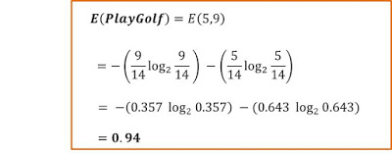
Step by Step Procedure for Building a Decision Tree
Step 2: Calculating Entropy for the classes (Play Golf)
First, we need to calculate the entropy for the Play Golf column.

Slide 14

Step by Step Procedure for Building a Decision Tree
Step 3: Calculate Entropy for Other Attributes After Split
For the other four attributes, we need to calculate the entropy after each of the split.
E(PlayGolf, Outloook)
E(PlayGolf, Temperature)
E(PlayGolf, Humidity)
E(PlayGolf,Windy)
The entropy for two variables is calculated using the formula:

Slide 15
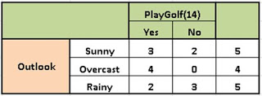
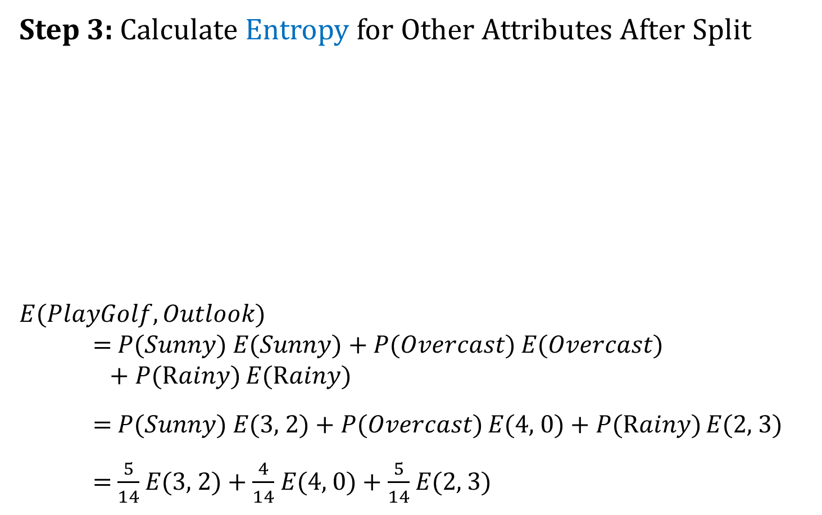
Step by Step Procedure for Building a Decision Tree
Step 3: Calculate Entropy for Other Attributes After Split
$E(PlayGolf, Outlook)$ = 𝑃(𝑆𝑢𝑛𝑛𝑦) 𝐸(𝑆𝑢𝑛𝑛𝑦) + 𝑃(𝑂𝑣𝑒𝑟𝑐𝑎𝑠𝑡) 𝐸(𝑂𝑣𝑒𝑟𝑐𝑎𝑠𝑡) + 𝑃(R𝑎𝑖𝑛𝑦) 𝐸(R𝑎𝑖𝑛𝑦)
= 𝑃(𝑆𝑢𝑛𝑛𝑦) 𝐸(3, 2) + 𝑃(𝑂𝑣𝑒𝑟𝑐𝑎𝑠𝑡) 𝐸(4, 0) + 𝑃(R𝑎𝑖𝑛𝑦) 𝐸(2, 3)
= $\frac{5}{14}$𝐸(3, 2) + $\frac{4}{14}$ 𝐸(4, 0) + $\frac{5}{14}$ 𝐸(2, 3)
Frequency Table for Outlook

Slide 16
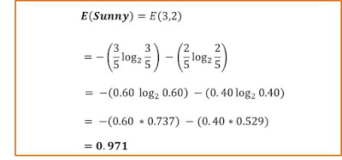
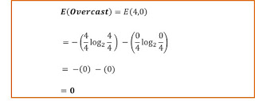
Step by Step Procedure for Building a Decision Tree
Step 3: Calculate Entropy for Other Attributes After Split
Now, calculate 𝐸(3, 2):
Similarly, calculate 𝐸(4, 0):

Slide 17
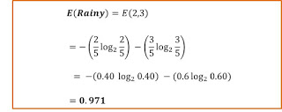
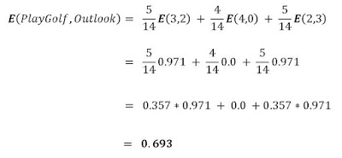
Step by Step Procedure for Building a Decision Tree
Step 3: Calculate Entropy for Other Attributes After Split
Similarly, calculate 𝐸(2, 3):
Now,

Slide 18
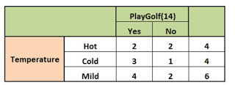
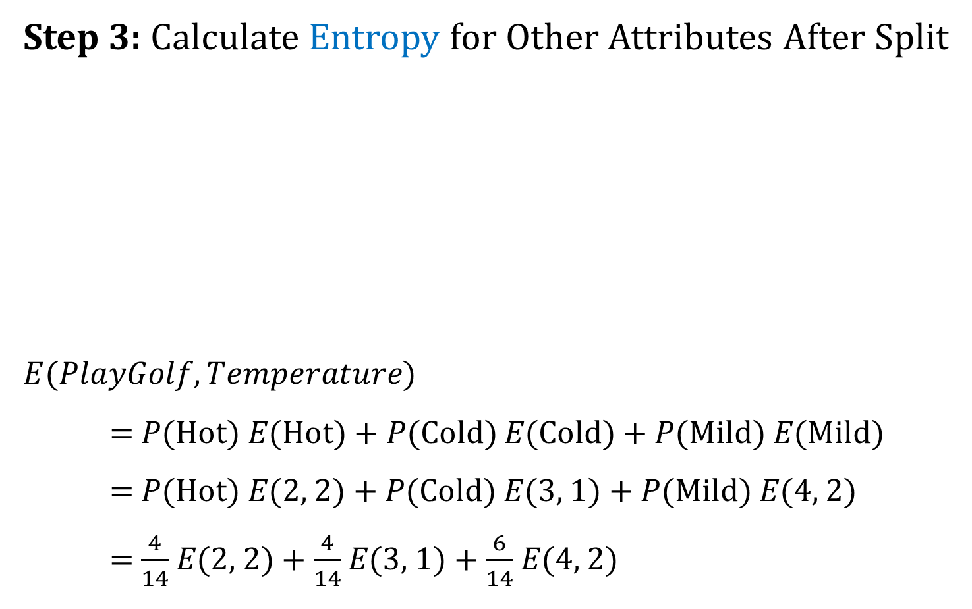
Step by Step Procedure for Building a Decision Tree
Step 3: Calculate Entropy for Other Attributes After Split
$E(PlayGolf,Temperature)$
= 𝑃(Hot) 𝐸(Hot) + 𝑃(Cold) 𝐸(Cold) + 𝑃(Mild) 𝐸(Mild)
= 𝑃(Hot) 𝐸(2, 2) + 𝑃(Cold) 𝐸(3, 1) + 𝑃(Mild) 𝐸(4, 2)
= $\frac{4}{14}$𝐸(2, 2) + $\frac{4}{14}$ 𝐸(3, 1) + $\frac{6}{14}$ 𝐸(4, 2)
Frequency Table for Temperature

Slide 19
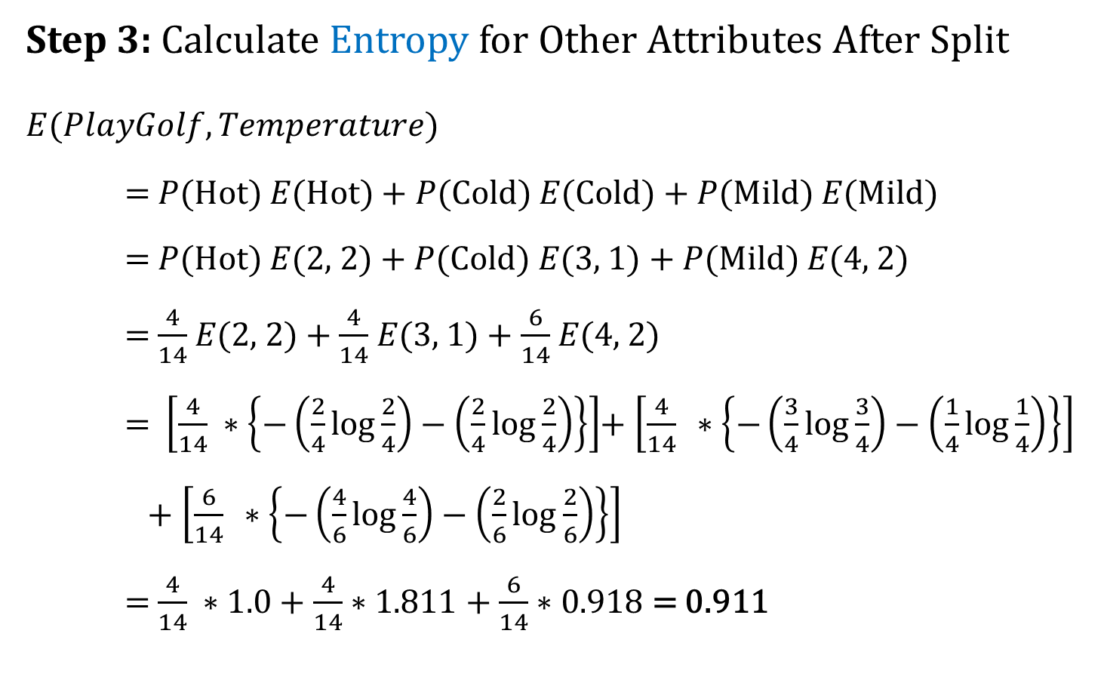
Step by Step Procedure for Building a Decision Tree
Step 3: Calculate Entropy for Other Attributes After Split
$E(PlayGolf,Temperature)$
= 𝑃(Hot) 𝐸(Hot) + 𝑃(Cold) 𝐸(Cold) + 𝑃(Mild) 𝐸(Mild)
= 𝑃(Hot) 𝐸(2, 2) + 𝑃(Cold) 𝐸(3, 1) + 𝑃(Mild) 𝐸(4, 2)
= $\frac{4}{14}$𝐸(2, 2) + $\frac{4}{14}$ 𝐸(3, 1) + $\frac{6}{14}$ 𝐸(4, 2)
= $\left[\frac{4}{14} ∗\left\{−\left(\frac{2}{4}\log{\frac{2}{4}}\right)−\left(\frac{2}{4}\log{\frac{2}{4}}\right)\right\}\right]$+ $\left[\frac{4}{14} ∗\left\{−\left(\frac{3}{4}\log{\frac{3}{4}}\right)−\left(\frac{1}{4}\log{\frac{1}{4}}\right)\right\}\right]$
+ $\left[\frac{6}{14} ∗\left\{−\left(\frac{4}{6}\log{\frac{4}{6}}\right)−\left(\frac{2}{6}\log{\frac{2}{6}}\right)\right\}\right]$
= $\frac{4}{14} ∗1.0$ + $\frac{4}{14}$ $∗1.811$ + $\frac{6}{14}$ $∗0.918$ = 0.911

Slide 20

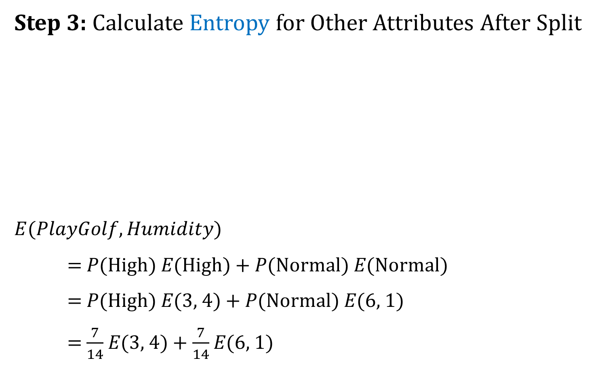
Step by Step Procedure for Building a Decision Tree
Step 3: Calculate Entropy for Other Attributes After Split
$E(PlayGolf,Humidity)$
= 𝑃(High) 𝐸(High) + 𝑃(Normal) 𝐸(Normal)
= 𝑃(High) 𝐸(3, 4) + 𝑃(Normal) 𝐸(6, 1)
= $\frac{7}{14}$𝐸(3, 4) + $\frac{7}{14}$ 𝐸(6, 1)
Frequency Table for Humidity

Slide 21
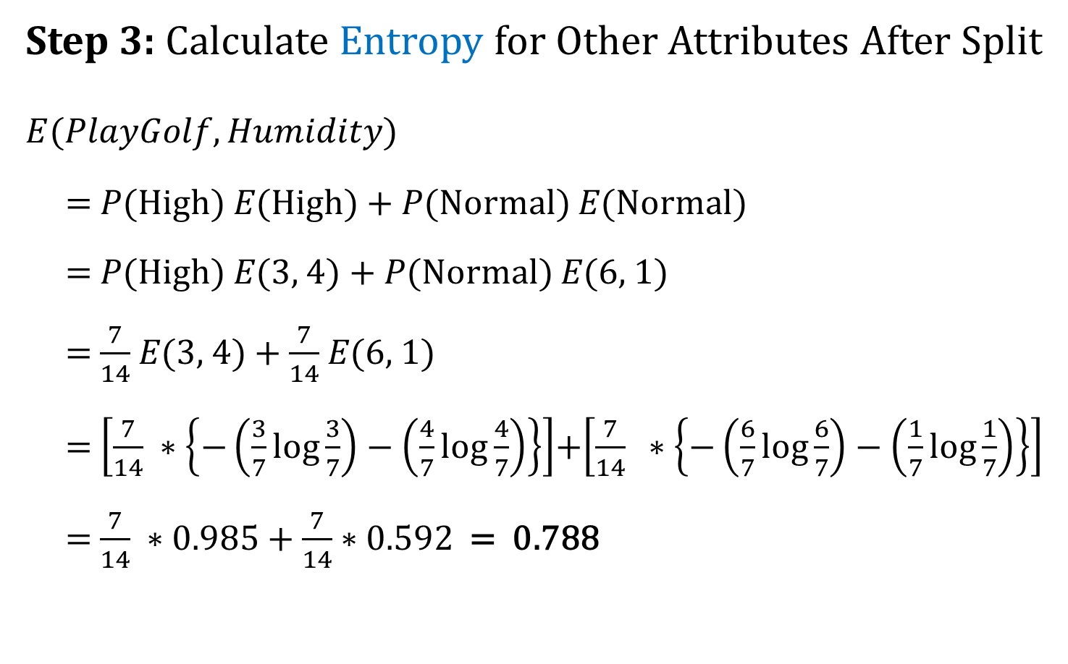
Step by Step Procedure for Building a Decision Tree
Step 3: Calculate Entropy for Other Attributes After Split
$E(PlayGolf,Humidity)$
= 𝑃(High) 𝐸(High) + 𝑃(Normal) 𝐸(Normal)
= 𝑃(High) 𝐸(3, 4) + 𝑃(Normal) 𝐸(6, 1)
= $\frac{7}{14}$𝐸(3, 4) + $\frac{7}{14}$ 𝐸(6, 1)
= $\left[\frac{7}{14} ∗\left\{−\left(\frac{3}{7}\log{\frac{3}{7}}\right)−\left(\frac{4}{7}\log{\frac{4}{7}}\right)\right\}\right]$+$\left[\frac{7}{14} ∗\left\{−\left(\frac{6}{7}\log{\frac{6}{7}}\right)−\left(\frac{1}{7}\log{\frac{1}{7}}\right)\right\}\right]$
= $\frac{7}{14} ∗0.985$ + $\frac{7}{14}$ $∗0.592$ = 0.788

Slide 22
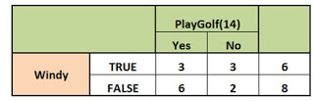

Step by Step Procedure for Building a Decision Tree
Step 3: Calculate Entropy for Other Attributes After Split
$E(PlayGolf,Windy)$
= 𝑃(True) 𝐸(True) + 𝑃(False) 𝐸(False)
= 𝑃(True) 𝐸(3, 3) + 𝑃(False) 𝐸(6, 2)
= $\frac{6}{14}$𝐸(3, 3) + $\frac{8}{14}$ 𝐸(6, 2)
Frequency Table for Windy

Slide 23

Step by Step Procedure for Building a Decision Tree
Step 3: Calculate Entropy for Other Attributes After Split
$E(PlayGolf,Windy)$
= 𝑃(True) 𝐸(True) + 𝑃(False) 𝐸(False)
= 𝑃(True) 𝐸(3, 3) + 𝑃(False) 𝐸(6, 2)
= $\frac{6}{14}$𝐸(3, 3) + $\frac{8}{14}$ 𝐸(6, 2)
=$\left[\frac{6}{14} ∗\left\{−\left(\frac{3}{6}\log{\frac{3}{6}}\right)−\left(\frac{3}{6}\log{\frac{3}{6}}\right)\right\}\right]$ +$\left[\frac{8}{14} ∗\left\{−\left(\frac{6}{8}\log{\frac{6}{8}}\right)−\left(\frac{2}{8}\log{\frac{2}{8}}\right)\right\}\right]$
= $\frac{6}{14} ∗1.0$ + $\frac{8}{14}$ $∗0.811$ = 0.892

Slide 24
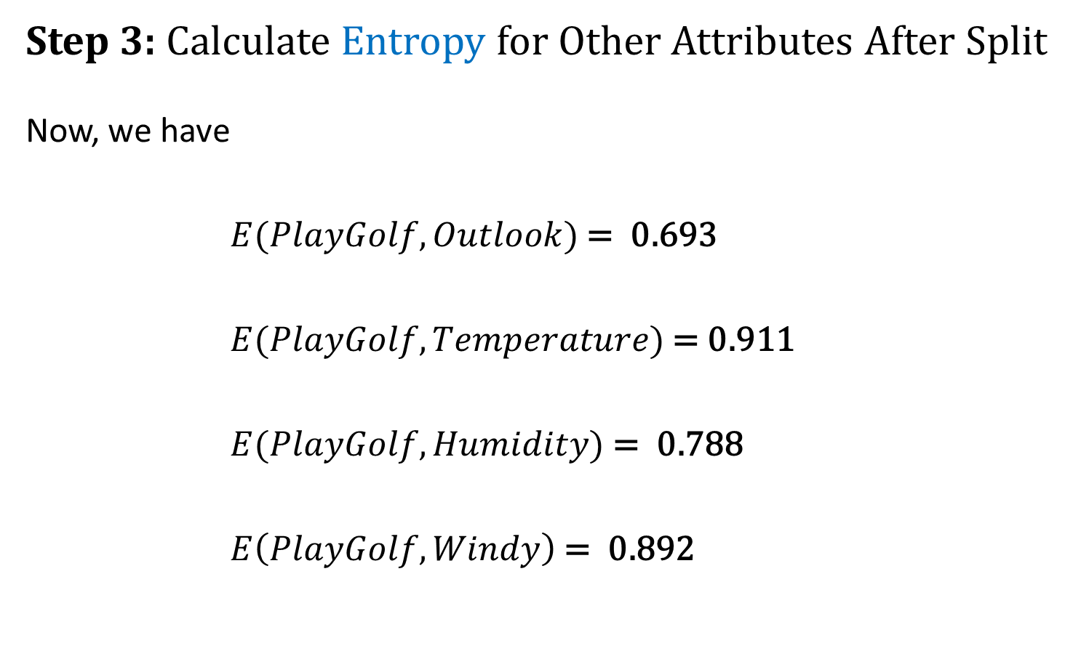
Step by Step Procedure for Building a Decision Tree
Step 3: Calculate Entropy for Other Attributes After Split
Now, we have
$E(PlayGolf, Outlook)$ = 0.693
$E(PlayGolf,Temperature)$ = 0.911
$E(PlayGolf,Humidity)$ = 0.788
$E\left(PlayGolf,Windy\right)$= 0.892

Slide 25
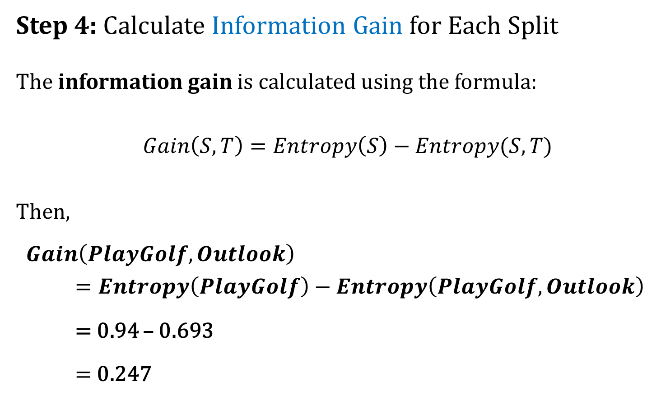
Step by Step Procedure for Building a Decision Tree
Step 4: Calculate Information Gain for Each Split
The information gain is calculated using the formula:
$Gain\left(S, T\right)=Entropy\left(S\right)−Entropy(S, T)$
Then,
$Gain\left(PlayGolf, Outlook\right)$
$=Entropy\left(PlayGolf\right)−Entropy\left(PlayGolf, Outlook\right)$
= 0.94 – 0.693
= 0.247

Slide 26
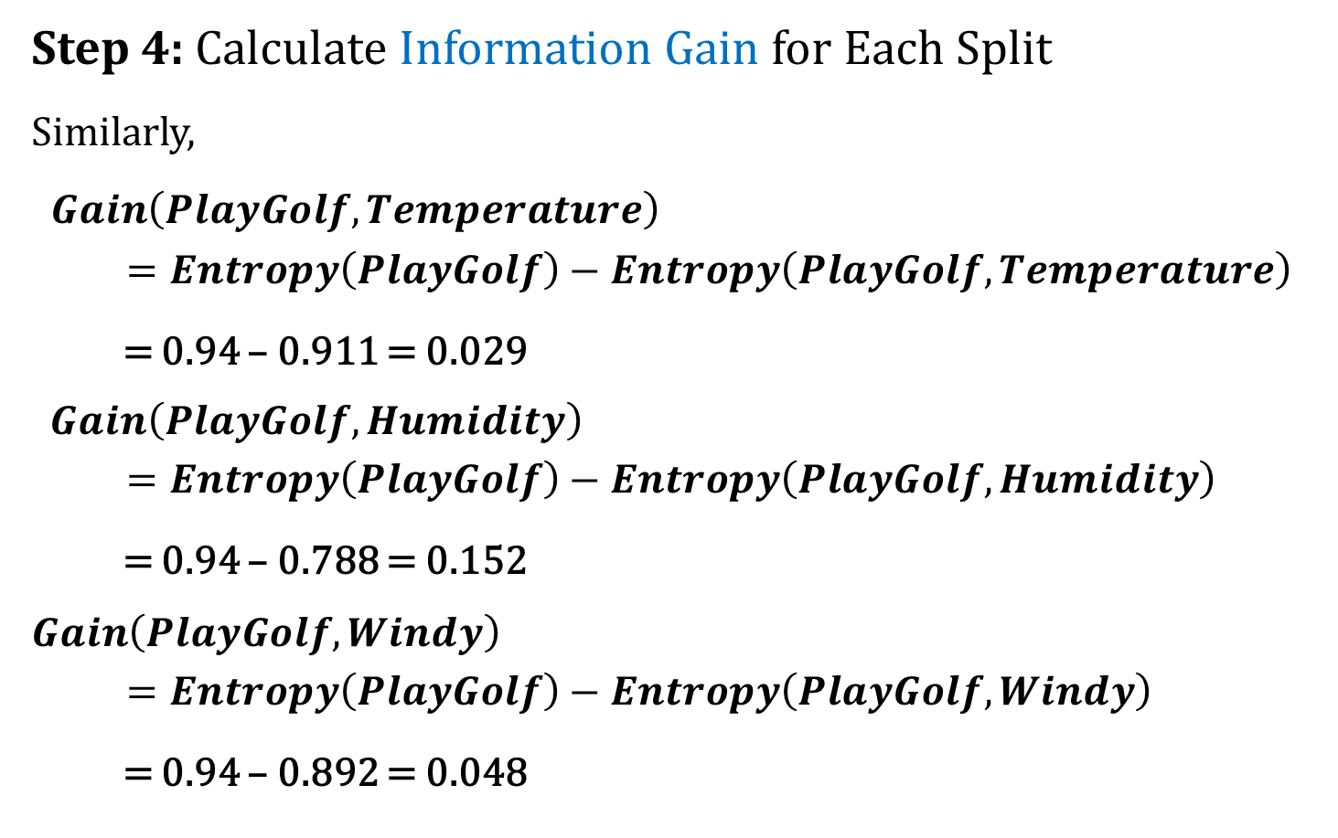
Step by Step Procedure for Building a Decision Tree
Step 4: Calculate Information Gain for Each Split
Similarly,
$Gain\left(PlayGolf, Temperature\right)$
$=Entropy\left(PlayGolf\right)−Entropy\left(PlayGolf,Temperature\right)$
= 0.94 – 0.911 = 0.029
$$Gain\left(PlayGolf, Humidity\right)$$
$=Entropy\left(PlayGolf\right)−Entropy\left(PlayGolf,Humidity\right)$
= 0.94 – 0.788 = 0.152
$$Gain\left(PlayGolf, Windy\right)$$
$=Entropy\left(PlayGolf\right)−Entropy\left(PlayGolf,Windy\right)$
= 0.94 – 0.892 = 0.048

Slide 27
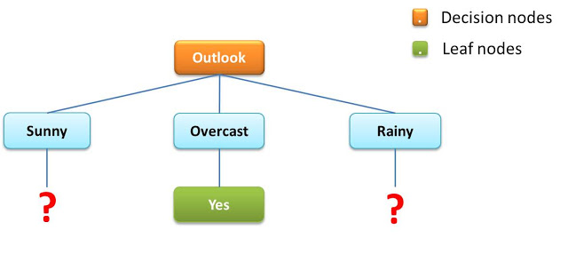
Step by Step Procedure for Building a Decision Tree
Step 5: Perform the First Split
Now, we split the tree based on the attribute with the highest information gain.
From our calculation, the highest information gain comes from Outlook. Therefore, the split will look like this:
Overcast outlook requires no further split because it is just one homogeneous group.
So we have a leaf node.
Decision Tree after first split

Slide 28
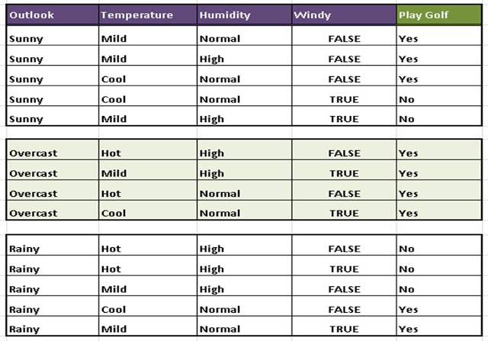
Step by Step Procedure for Building a Decision Tree
Step 5: Perform the First Split
Now, the split of the original table will look like this:
Initial Split using Outlook

Slide 29
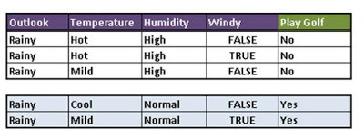
Step by Step Procedure for Building a Decision Tree
Step 6: Perform Further Splits
Sunny and Rainy attributes needs to be split.
Rainy outlook can be split using either Temperature, Humidity or Windy.
Now, What attribute would best be used for this split? And Why?
Humidity because it produces homogenous groups.
Split using Humidity

Slide 30
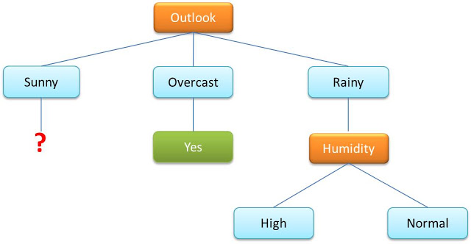
Step by Step Procedure for Building a Decision Tree
Step 6: Perform Further Splits
Rainy attribute could be split using High and Normal attributes and that would give us the tree below:
Split using the Humidity Attribute

Slide 31
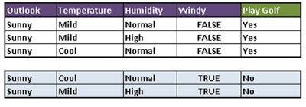
Step by Step Procedure for Building a Decision Tree
Step 6: Perform Further Splits
Let’s now go ahead to do the same thing for the Sunny outlook.
Sunny outlook can be split using either Temperature, Humidity or Windy.
Now, What attribute would best be used for this split? And Why?
Windy because it produces homogenous groups.
Split using Windy Attribute

Slide 32
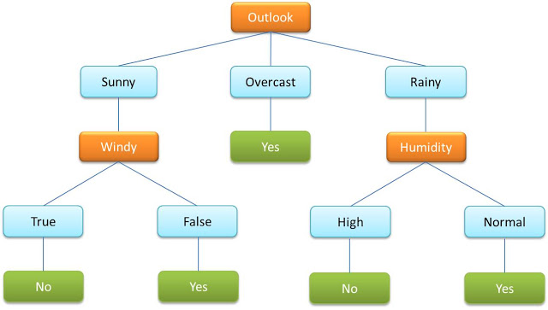
Step by Step Procedure for Building a Decision Tree
Step 6: Perform Further Splits
If we do the split using the Windy attribute, we would have the final tree that would require no further splitting!
Final Decision Tree

Slide 33
Advantages and Disadvantages of ID3
Advantages of ID3
Simple and easy to understand.
Requires little training data.
Can work well with data with discrete and continuous attributes.
Disadvantages of ID3
Can lead to overfitting.
May not be effective with data with many attributes.

Slide 34
Applications of ID3
Fraud detection: ID3 can be used to develop models that can detect fraudulent transactions or activities.
Medical diagnosis: ID3 can be used to develop models that can diagnose diseases or medical conditions.
Customer segmentation: ID3 can be used to segment customers into different groups based on their demographics, purchase history, or other factors.
Risk assessment: ID3 can be used to assess risk in a variety of different areas, such as insurance, finance, and healthcare.
Recommendation systems: ID3 can be used to develop recommendation systems that can recommend products, services, or content to users based on their past behavior or preferences.
Amazon uses ID3 to recommend products to its customers.
Netflix uses ID3 to recommend movies and TV shows to its users.
Spotify uses ID3 to recommend songs and playlists to its users.
LendingClub uses ID3 to assess the risk of approving loans to borrowers.
Healthcare organizations use ID3 to diagnose diseases, predict patient outcomes, and develop personalized treatment plans.

Slide 35
Thank You

